Slide 1

Intro to jQuery Geo
write less, map more
Ryan Westphal
AppGeo
@ryanttb
Notes:
Thank you for coming. My name is Ryan Westphal and I am a mapping web developer for AppGeo, in Boston. I make a lot of mapping website and love JavaScript. I’m here to talk about jQuery Geo, our open-source JavaScript mapping API. But first, an intro to this intro…

Slide 2
How Long?
AppGeo | 20 years
Me + GIS | 6 years
Notes:
AppGeo has just celebrated our 20th anniversary! I’ve been working there for over six and doing mapping and JavaScript the whole time.

Slide 3
Internal?
Internal ASP map widget | 8 years (O_o)
Internal JS map widget | 4 years
jQuery Geo | 1 years
Notes:
When I started, AppGeo already had a map widget. It was ASP.NET and some JavaScript. About four years ago, I rewrote it in 100% JavaScript. I also added support for tiling (but I don’t think that’ll catch on). We were using our internal widget for almost all projects. About a year ago, we realized that we’ve been using a lot of open-source software: jQuery itself, PostGIS, & GeoServer. We decided we wanted to give back and redesigned the widget as a jQuery plugin.

Slide 4


In the box
FEATURE SET
SIZE

Slide 5

jQuery = JavaScript <3
“jQuery is designed to change the way that you write JavaScript”
Notes:
It’s not just the JavaScript in the library. It’s the community, the paradigm, the whole mentality. No byte is too good to cut. Speed, size, and syntax are top priority.

Slide 6
jQuery Geo = JavaScript Mapping <3
jQuery Geo is designed to change the way that you write JavaScript…for mapping
jQuery Geo += Documentation <3
Notes:
jQuery Geo applies that mentality to JavaScript mapping.

Slide 7


Slide 8
make it go
<script src="//code.jquery.com/jquery-1.7.1.min.js"> </script>
<script src="//code.jquerygeo.com/jquery.geo-1.0a4.min.js"> </script>

Slide 9
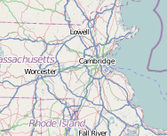
a map
$( “#map” ).geomap( );
or
$( “#map” ).geomap( { center: [ -71.0595678, 42.3604823 ], zoom: 7 } );
or…

Slide 10
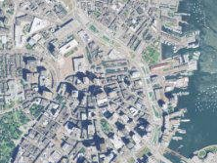
other web mercator
$( “#map” ).geomap( { center: [ -71.0595678, 42.3604823 ], zoom: 7, services: [ {
id: "Ortho_MapQuest",
type: "tiled",
src: “http://oatile1.mqcdn.com/naip/” + “{{:zoom}}/{{:tile.column}}/{{:tile.row}}.png”
} ] } );
or…

Slide 11
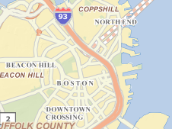
other projection (dynamic)
$( “#map” ).geomap( { center: [ 235670.21967, 900771.290247 ], zoom: 13, bboxMax: [ 31789.1658, 790194.4183, 337250.8970, 961865.1338 ], services: [ {
id: "massgis_basemap",
type: "shingled",
src: “//giswebservices.massgis.state.ma.us/geoserver/wms” + “?LAYERS=massgis_basemap&SERVICE=WMS&VERSION=1.1.1&REQUEST=GetMap&FORMAT=image/png&SRS=EPSG:26986” + “&BBOX={{:bbox}}&WIDTH={{:width}}&HEIGHT={{:height}}”
} ] } );
etc.

Slide 12
jQuery UI “widget factory” (options)
var map = $( “#map” ).geomap( );
map.geomap( “option”, “center”, [ -71.0, 42.36 ] );
var bbox = map.geomap( “option”, “bbox” );
map.geomap( “option”, { zoom: 8, center: [ -72.5, 41.27 ] } );

Slide 13
functions
map.geomap( “zoom”, +2 );
map.geomap( “opacity”, 0.8 ).geomap( “toggle” );

Slide 14
modes
var map = $( “#map” ).geomap( { mode: “pan” } );
map.geomap( “option”, “mode”, “zoom” );
static
drawPoint, drawLineString, drawPolygon
measureLength, measureArea

Slide 15
events
var map = $( “#map” ).geomap( { bboxchange: function( e, geo ) { // GeoJSON! }, click: function( e, geo ) { // GeoJSON! }, shape: function( e, geo ) { // GeoJSON! } } );

Slide 16
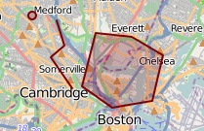
shapes
var map = $( “#map” ).geomap( { mode: “drawPoint”, shape: function( e, geo ) { map.geomap( “append”, geo ); } } );

Slide 17
shapes
var map = $( “#map” ).geomap( { mode: “drawPoint”, shape: function( e, geo ) { var shapes = map.geomap( “find”, geo, 3 ); if ( shapes.length > 0 ) { map.geomap( “remove”, shapes[ 0 ] ); } } } );

Slide 18

style
map.geomap( “option”, “shapeStyle”, { color: "green“ } );
borderRadius, color, fill, opacity, visibility, etc.

Slide 19
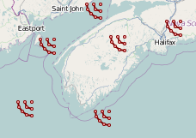
labels
map.geomap( “append”, geo, ‘<div class=“logo”></div>’ );
.marker { width: 24px; height: 24px; background: url(../img/logo.png); position: relative; }

Slide 20
Thank you!
http://jquerygeo.com
@ryanttb, @jQueryGeo
BoF: 1pm today!
Code sprint: tomorrow!

